Slide 1
MOVIE TICKET BOOKING WITH TKINTER AND DATABASE
BY: ARUNCHANDRA HALEMANI
2GI20CS021

Slide 2
OBJECTIVE OF THE PROJECT
To provide with beautiful Graphical User Interface(GUI using Tkinter) for users to book ticket.
Dynamic updating of available tickets.
Detailed entry of user details for booking tickets.
Multiple ticket booking at once.

Slide 3
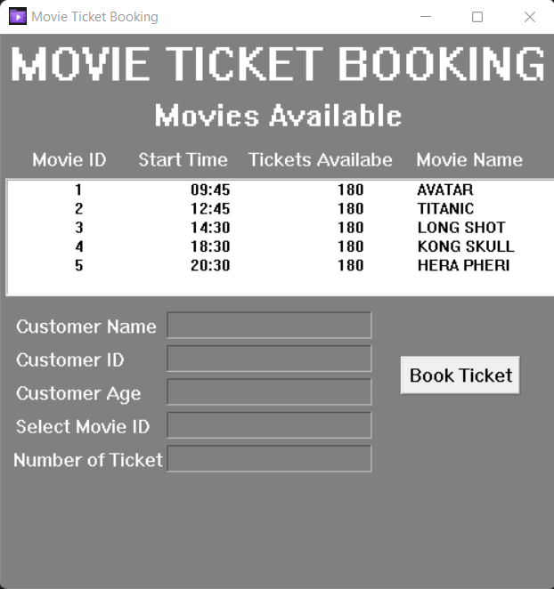
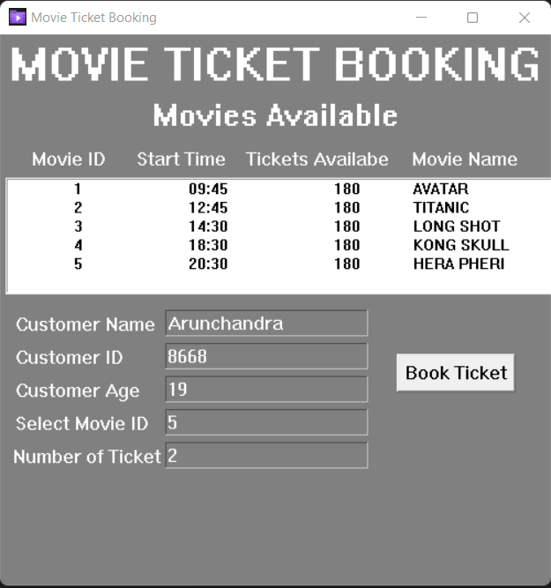
Screenshot of project

Slide 4
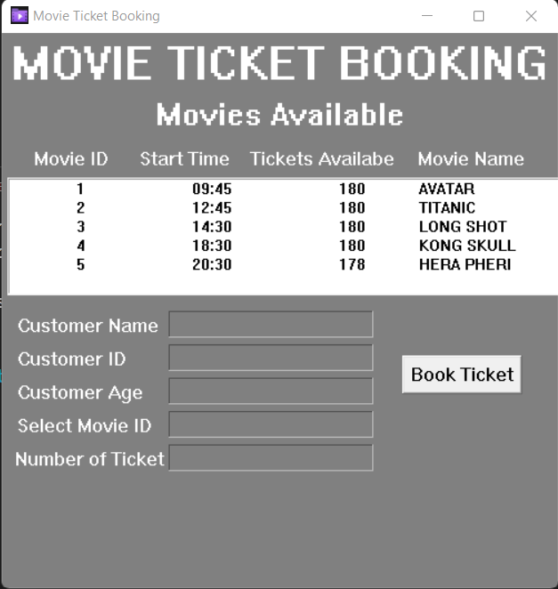
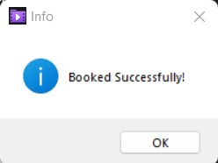
Dynamic update of tickets
2 tickets are booked!

Slide 5
reference
YOUTUBE LINKS:
https://youtu.be/TuLxsvK4svQ (Python Tkinter GUI by BRO CODE).
https://youtu.be/d56sf29tSzw (Python Tkinter with MySQL database by FAUXCODE).
TEXT BOOK:
Python Programming, Michael Urban and Joel Murach, 2016
Python Programming, O’Reilly, 4th edition, 2010

